Slide 1
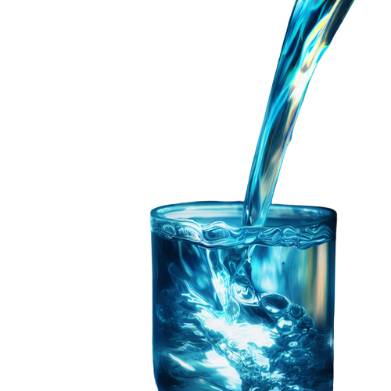
Sustainable Development Goals (SDGs)
#Unlocking the Power of Clean Water: Empowering Communities, Transforming Lives.
Clean Water and Sanitation for a Sustainable Future.

Slide 2
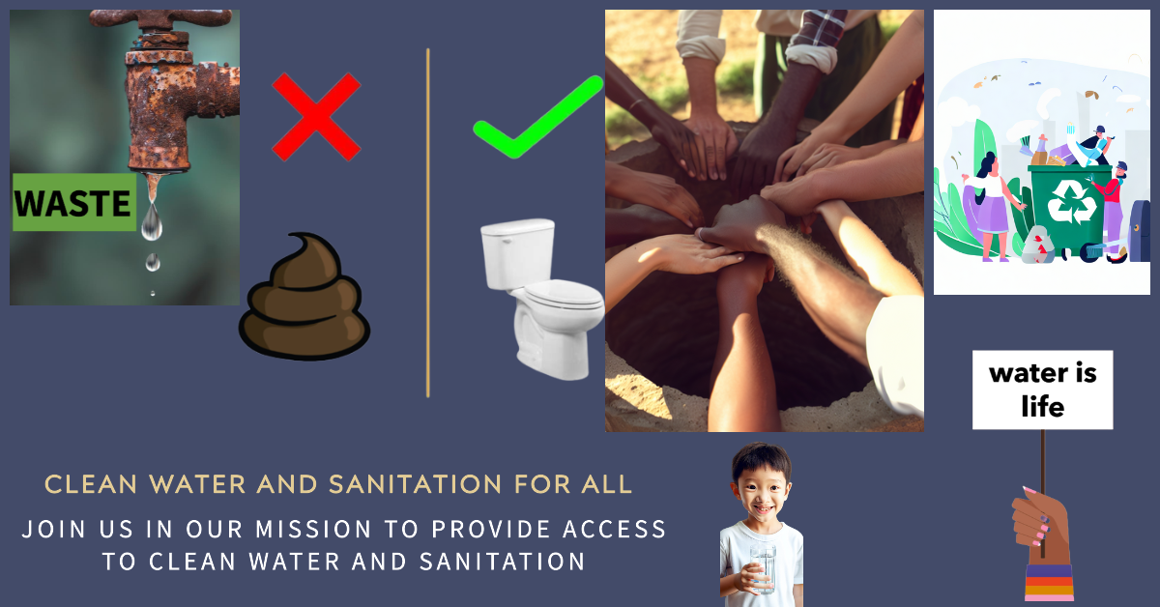

Slide 3


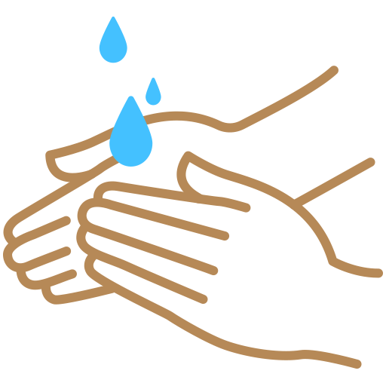
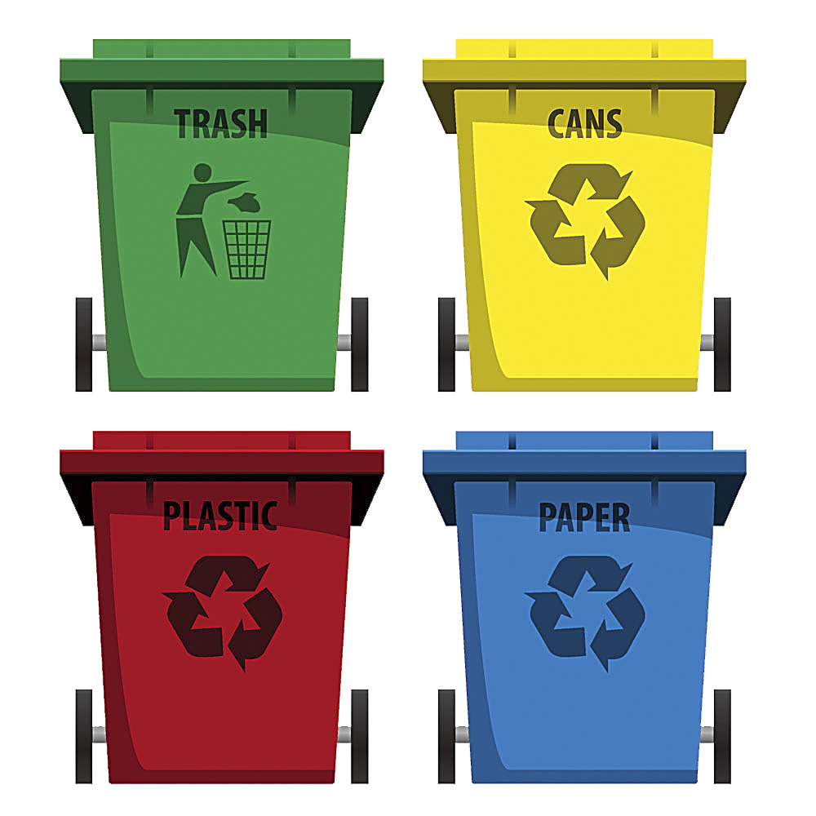



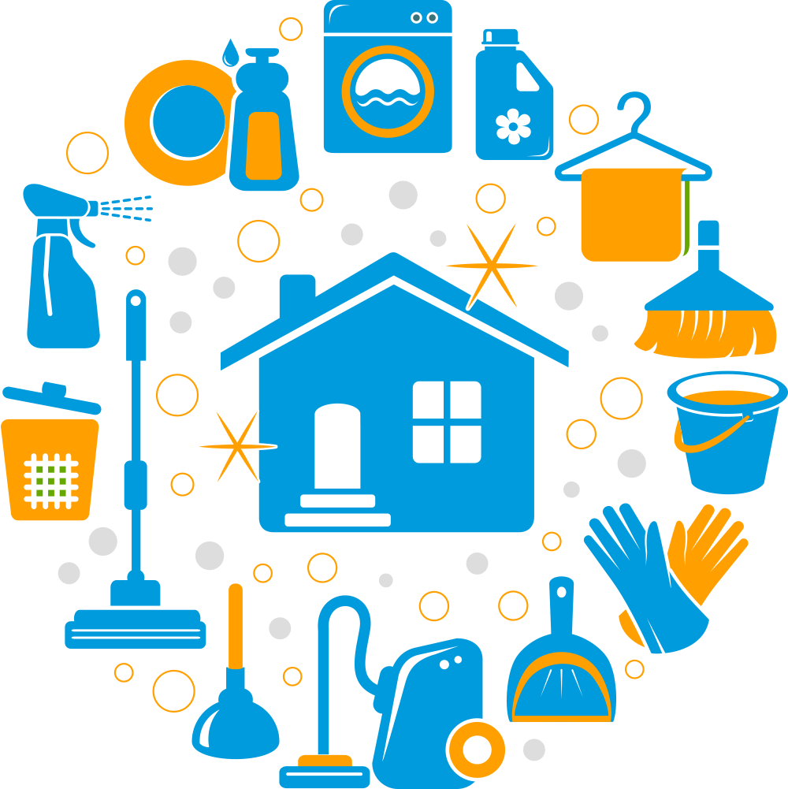
Clean Water is our Right & Sanitation is our Responsibility

Slide 4
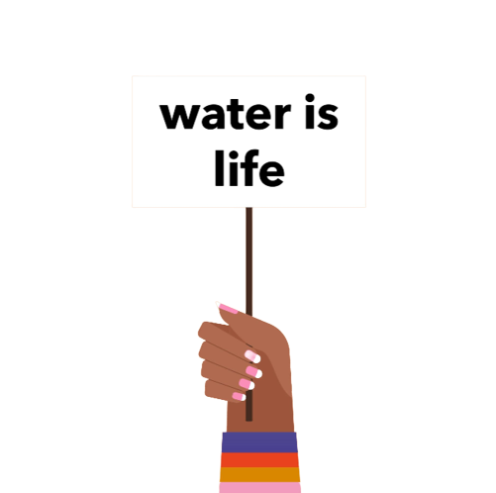
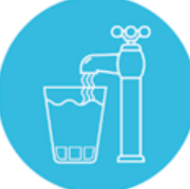

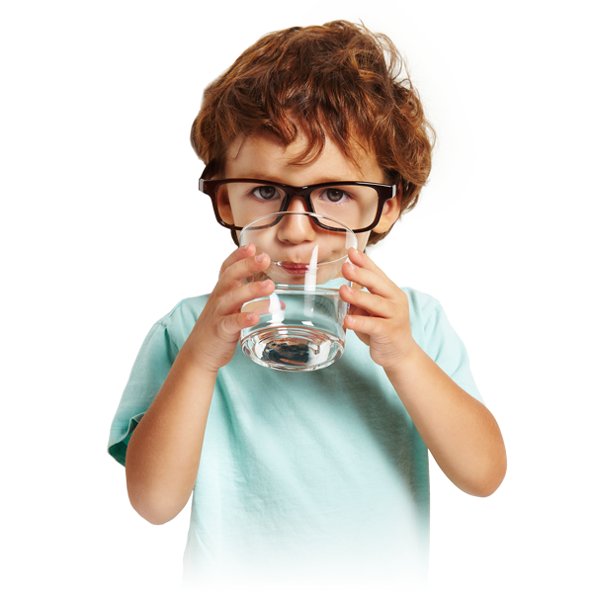


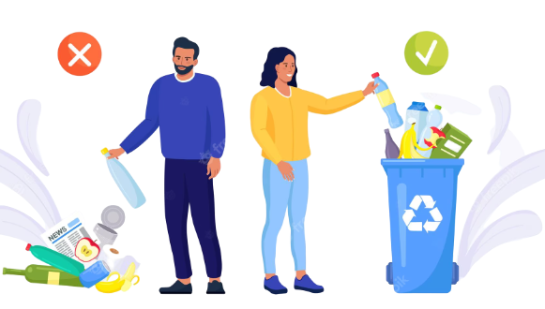

Sanitation is not as tough as it seems
Water feels abundant but it is not.

